Slide 1
Public Housing Resale Market in Singapore Analysis
By: Imam Maghfir Ramadhan

Slide 2
Background & Objectives
Background
There are various different flat types and flat models managed by HDB (Housing & Development Board) that provide flexibility to cater the living requirements of the residents. Resale flat price are influenced by many factors.
Objectives
Developing
Segmentation Model
Analyzing Overall Picture
Analyzing overall picture of the flat resale prices from the data
Developing segmentation model to categorize each flat affordability
Objectives
Creating
Prediction Model
Determining Key Factors
Creating regression model to predict the resale price
Determine key factors that affected the flat resale price

Slide 3
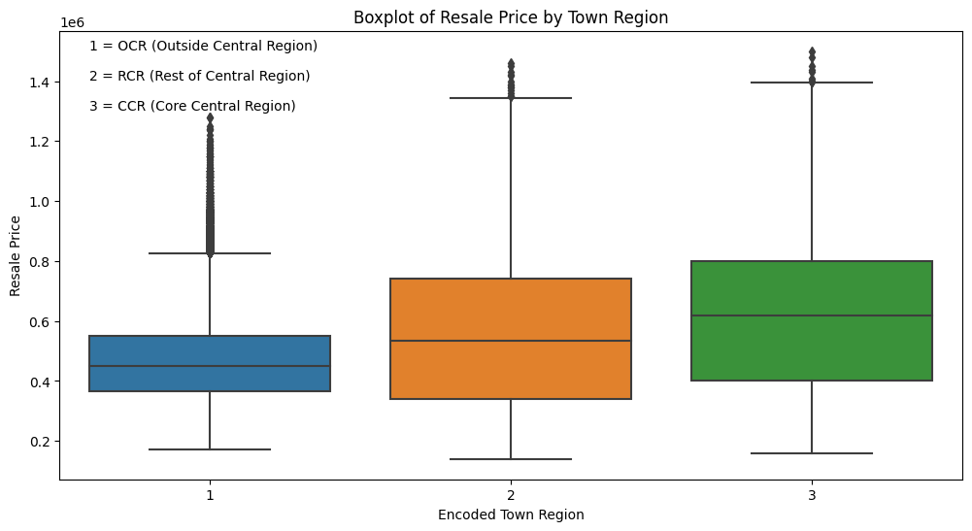
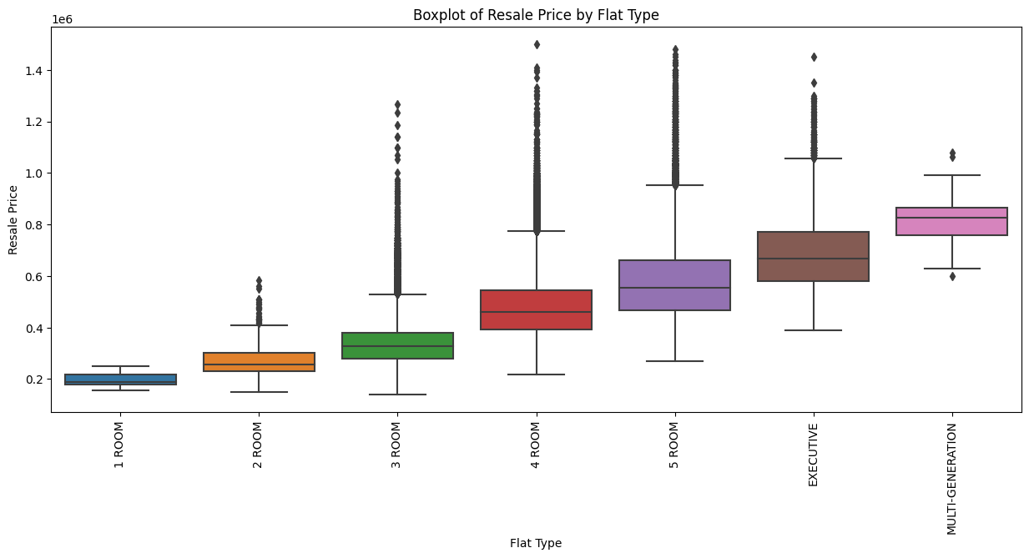
Analyzing Overall Picture
Flat Location Analysis
Resale prices vary between different towns
Among the market segments (CCR, RCR, and OCR), CCR towns have the highest median resale prices
Mature towns* tend to have higher average resale prices compared to non-mature towns
Flat Description Analysis
Flat resale price also varies depending on their descriptions
Price shows a positive correlation with flat floor area SQM, number of rooms, storey median, and remaining lease in months, while vary price variation for flat model
*Mature towns: Towns that are over 20 years old and located in areas with more residential amenities.

Slide 4
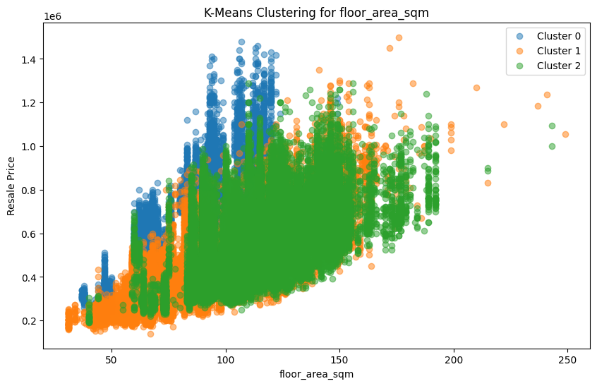
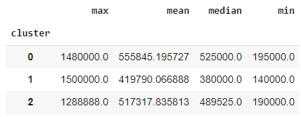
Developing Segmentation Model – Kmeans Clustering
Segmentation Model
Resale price distribution shows vary centroid among each cluster
Therefore, it can be inferred that:
Cluster 1 as the "Very affordable" category
Cluster 2 as the "Affordable" category
Cluster 0 as the "Not Affordable" category
Factors associated are from the correlation between the key factors toward the resale price
Resale Price Aggregation based on Cluster

Slide 5
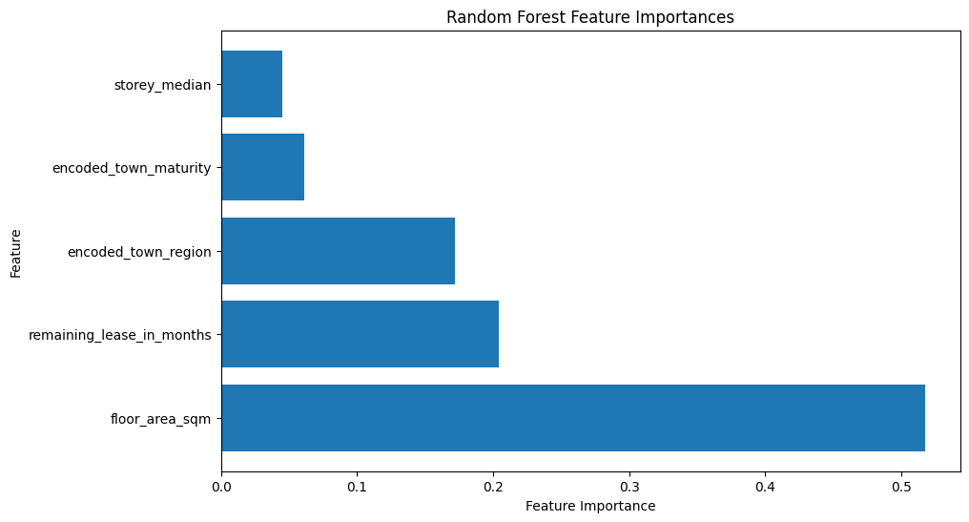

Determining Key Factors
Key Factors
The value shows how the correlation between factors
Resale price has a correlation with factors:
Floor area sqm (High correlation)
Remaining lease in months and town region (Moderate correlation)

Slide 6
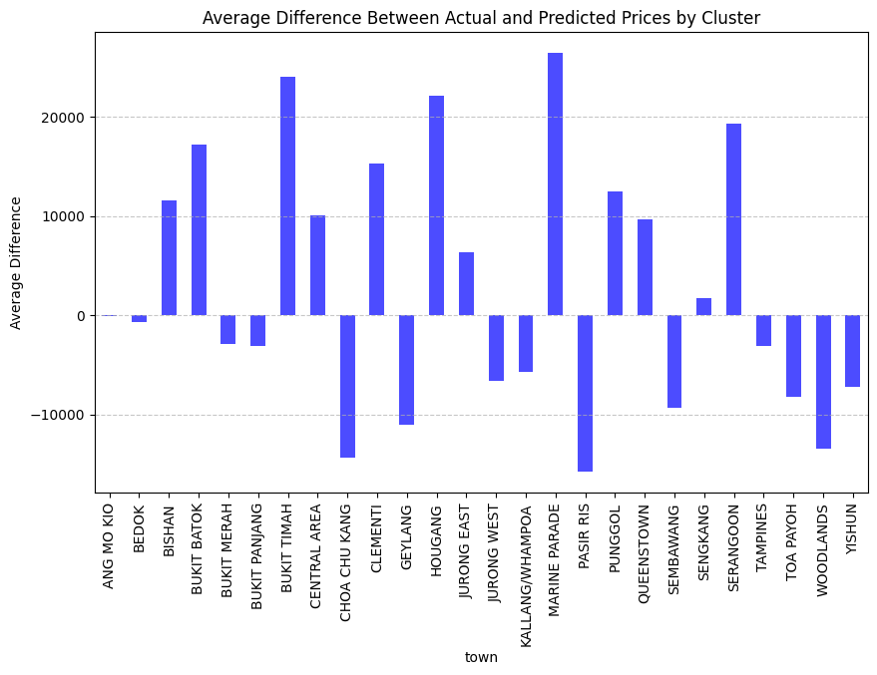
Creating Prediction Model – Random Forest
Prediction Model
Random Forest is chosen as the prediction model because it had the highest R² value and the lowest error metrics. Conclusion & Recommendation
Top 3 factors that affect the flat resale price are floor area, remaining lease, and town region.
Top 3 average under value flat that recommend to buy is located in PASIR RIS, CHOA CHU KANG, AND WOODLANDS
IF the case the property agent looking for specific flat type (based on room), it is recommended to purchase the flat on:
1 Room (BUKIT MERAH)
2 Room (CHOA CHU KANG)
3 Room (PASIR RIS)
4 Room (PASIR RIS)
5 Room (CHOA CHU KANG)
Executive (BUKIT MERAH)
Multi Generation (YISHUN)
Model | Metrics
Model | MAE | MSE | RMSE | R^2
Linear Regression | 73,158 | 8,437,908,729 | 91,858 | 0.71
Decision Tree Regression | 58,664 | 6,782,553,602 | 82,356 | 0.76
Random Forest Regression | 51,317 | 4,879,043,048 | 69,850 | 0.83

